Slide 1
Hands-on Workshop:
Introduction to Software Defined Instrumentation
Monica Ignat – Applications Engineering Manager
Cristina Suteu – Software Developer

Slide 2


Who are we?
Founded
1965
Headquarters
Norwood, MA
Employees
~15,000
Countries
20+
Products
~45,000 SKUs
Over 4700 patents and $4 billion R&D investment in the past 10 years.
Customers
125,000
Publicly Listed
NASDAQ:ADI
Part of S&P 500 and NASDAQ 100
Design Centers
~45
Global Manufacturing
U.S. (Massachusetts, California,
Washington), Ireland, Philippines, and Malaysia
Notes:
Compania Analog Devices, fondata in anul 1965, este una dintre cele mai mari companii producatoare de circuite integrate, avand un rol fundamental in a converti fenomene din viata reala precum: temperatura, presiune, sunet, lumina, viteza, miscare si semnale radio intr-un limbaj digital, pentru a fi ulterior folosite in dispozitive echipamente electronice. La momentul actual, Analog Devices este cel mai mare supplier pentru industria de convertoare analog-digitale si digital-analogice. Pe langa acestea, din portofoliul nostru fac parte si componente de signal conditioning, precum: amplificatoare operationale, comparatoare, referinte de tensiune; parte de management de putere, care include redresoarele de tip switching sau liniare, managementul bateriilor si drivere pentru LEDuri, chipuri de clock, senzori, circuite integrate cu aplicatii RF, procesoare si microcontrolere.
Compania numara aproximativ 15.000 de angajati, avand filiale in peste 20 de tari.

Slide 3






Technologies for Today’s and Tomorrow’s Innovations
Autonomous Transportation and Machines
Automotive Electrification
5G and Next-Gen Connectivity
Digital Health
Industry 4.0 and Smart Energy
Immersive Consumer Experiences
Notes:
O parte dintre domeniile cheie pe care le targetam sunt: masini si transport autonom, automotive, comunicatii, dispositive medicale, industrie si consumer markets.
rol activ si foarte important in dezvoltarea noilor tehnologii

Slide 4
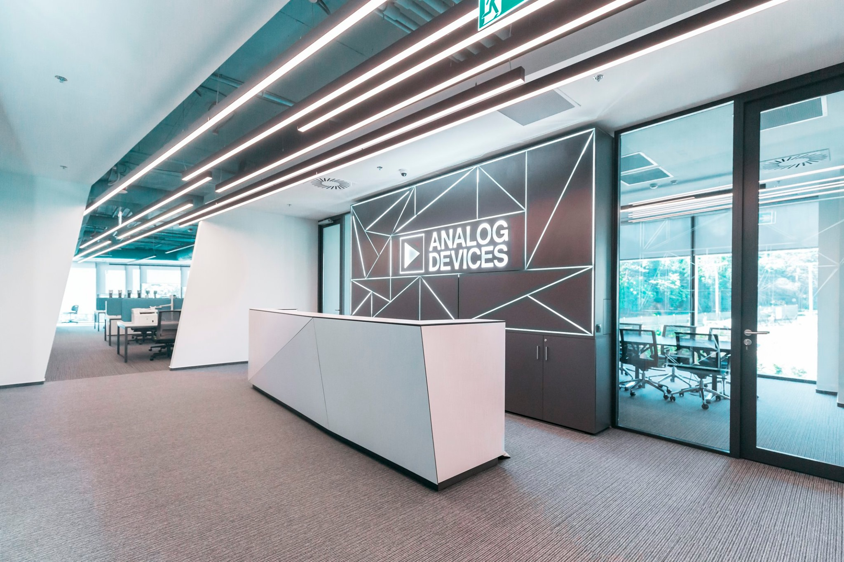
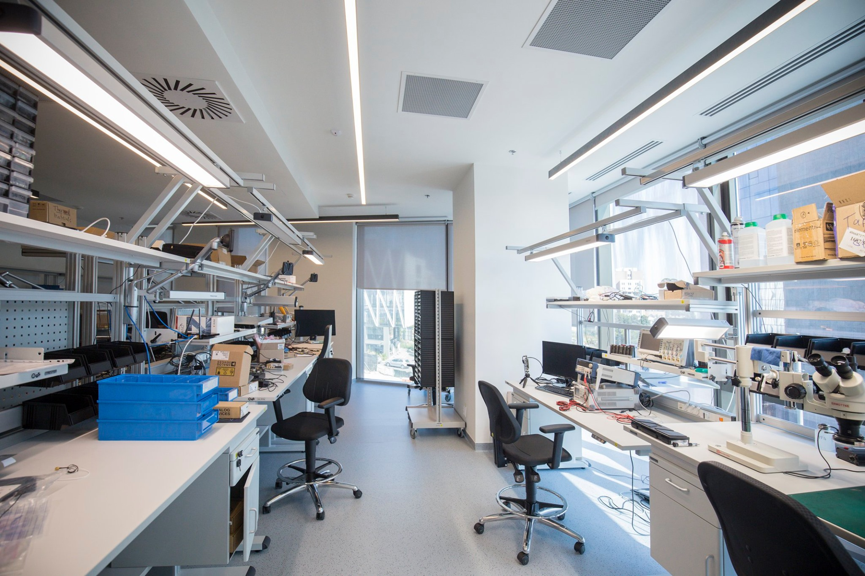
ADI Romania Design Center
Founded in 2011
Office 1 - UBC Riviera
1,000 square meters, 100 people capacity
Office 2 - UBC Tower
1,000 square meters, 120 people capacity
Multidisciplinary team
Hardware design
FPGA development (VHDL, Verilog)
Embedded software (C/C++, Linux)
Applications software (Python, MATLAB, C++)
Devops (Jenkins, Microsoft Azure, CI/CD)
System architecture
UX design
Program/Project management
Project fields
RF Communications
Precision & High-Speed Instrumentation
Depth, Perception and Ranging (ToF, LIDAR)
Industrial Automation

Slide 5
Agenda
Part 1
What is Software Defined Instrumentation?
Introduction to ADALM2000 – features, usage, etc.
ADALM hardware architecture, block diagram, design
ADALM2000 add-on boards
Getting started with ADALM2000
Scopy software – overview, install, using the app, instruments
Part 2
Instructor-led demo
Demo 1 - Scope and Signal generator channels, Network Analyzer instrument – Cascaded LP filters
Demo 2 - Digital Pattern Generator and Scope – AD5626 component – SPI-controlled and analog signal visualized using Scope
Q&A session

Slide 6
Hands-on Workshop:
Introduction to Software Defined Instrumentation
Part 1
ADALM2000 features, architecture, design
Getting started with ADALM2000 (M2K)
Scopy software – overview, install, using the app, instruments

Slide 7
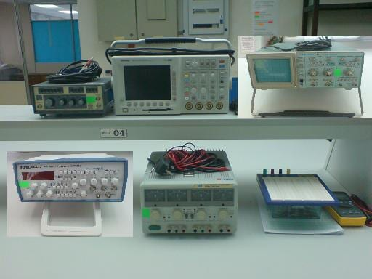
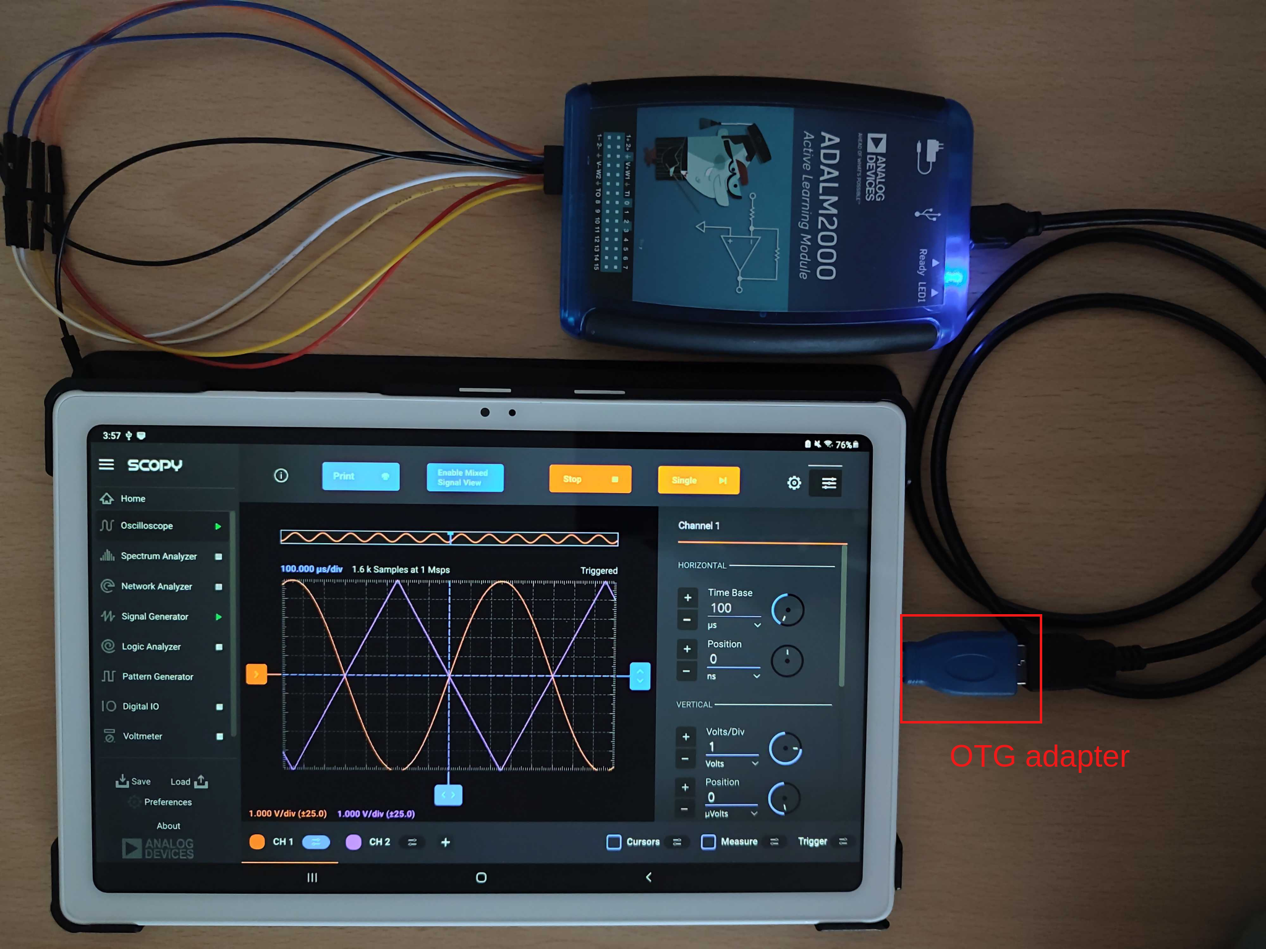
What is Software Defined Instrumentation?
A single device encapsulating more instruments used for measurements, signal generation, signal acquisition, etc., powered by a PC open-source software that allows the user to customize the measurements, since the software is residing more on the host PC/mobile device instead of on the instrument.
Bonus: it has a pocket size!
https://www.hitelengineering.com/electronics-lab

Slide 8
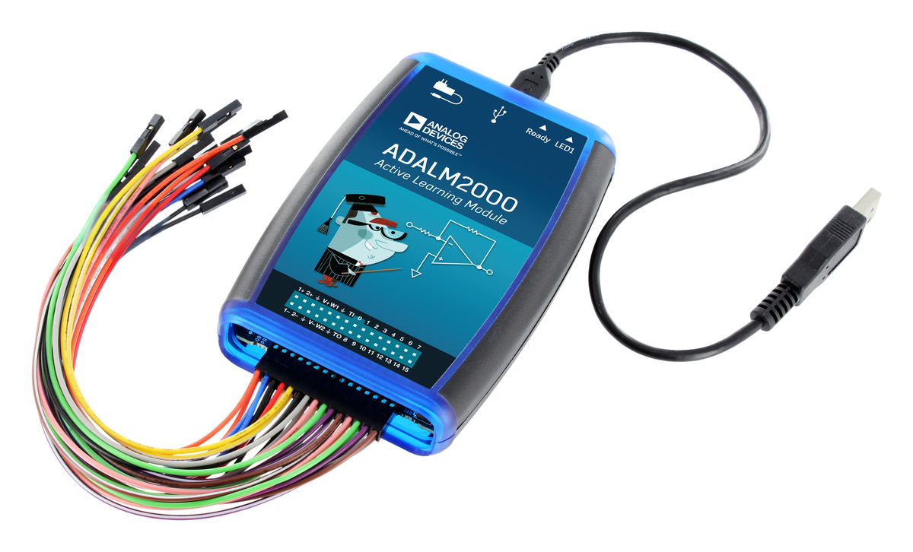
Introduction to ADALM2000
The ADALM2000 (M2K) Advanced Active Learning Module is an affordable USB-powered data acquisition module, that can be used to introduce fundamentals of electrical engineering in a self or instructor lead setting.
With 12-bit ADCs and DACs running at 100 MSPS, brings the power of high-performance lab equipment to the palm of your hand, enabling electrical engineering students and hobbyists to explore signals and systems into the tens of MHz without the cost and bulk associated with traditional lab gear.
When coupled with Analog Devices' Scopy™ graphical application software running on a computer, provides the user with high performance instrumentation.
Notes:
What is a software defined instrumentation device – a lab equipment used for measurements, instrumentation category, powered by a PC software that replaces traditional instruments one can find in an electronics laboratory.
ADALM2000 is an example of such device – with powerful features and easy to use software, eliminates the need of having a traditional lab gear.

Slide 9
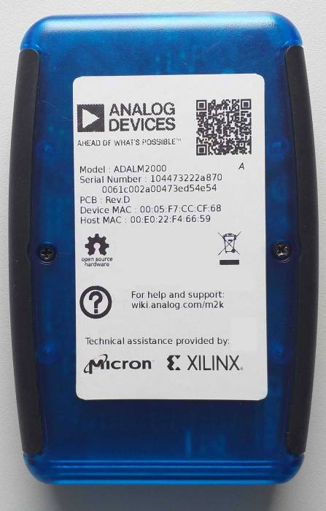
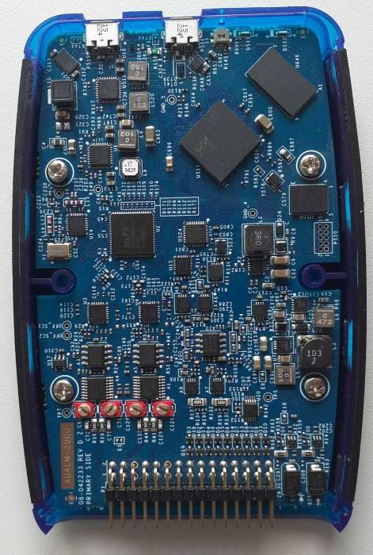
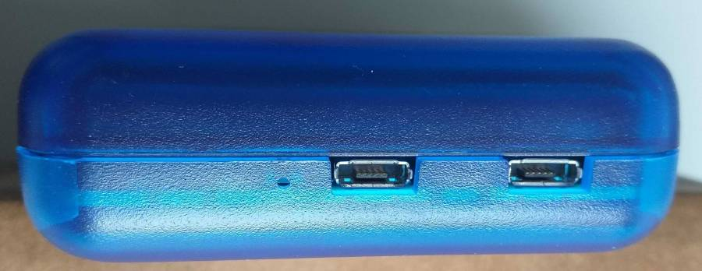
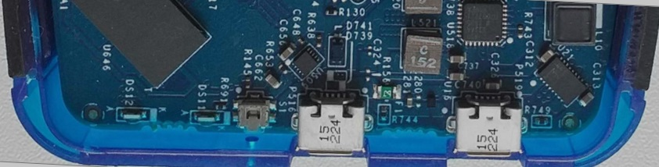
ADALM2000 (M2K)
Removing the case
Includes a button and two USB connectors

Slide 10
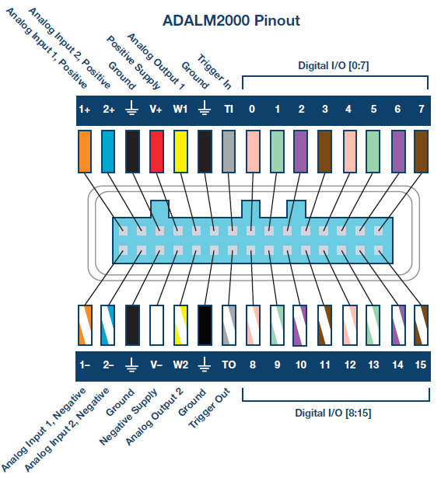
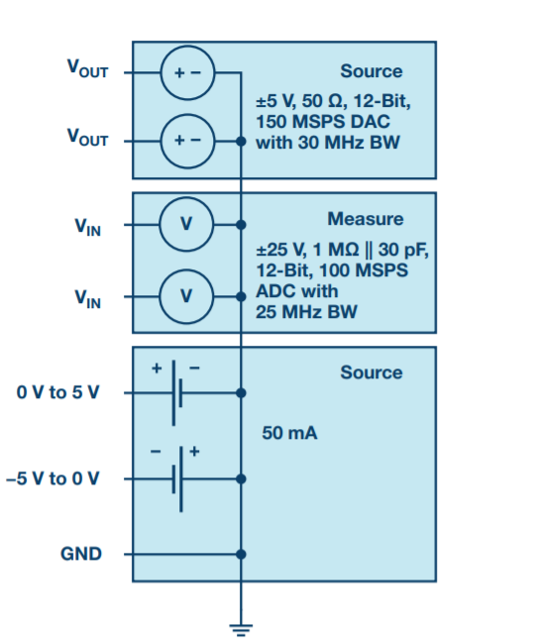
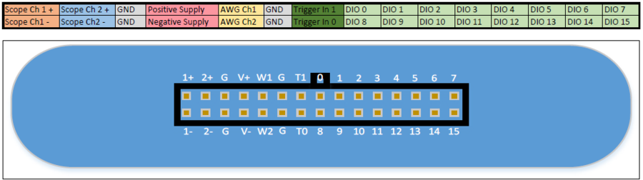
ADALM2000 features
Two-channel oscilloscope with differential inputs
Two-channel arbitrary function generator
16-channel digital logic analyzer (3.3V CMOS and 1.8V or 5V tolerant, 100MS/s)
16-channel pattern generator (3.3V CMOS, 100MS/s)
16-channel virtual digital I/O
Two input/output digital trigger signals for linking multiple instruments (3.3V CMOS)
Two-channel voltmeter (AC, DC, ±25V)
Network analyzer – Bode, Nyquist, Nichols transfer diagrams of a circuit. Range: 1Hz to 10MHz
Spectrum Analyzer – power spectrum and spectral measurements (noise floor, SFDR, SNR, THD, etc.)
Digital Bus Analyzers (SPI, I²C, UART, Parallel)
Two programmable power supplies (0…+5V , 0…-5V)

Slide 11
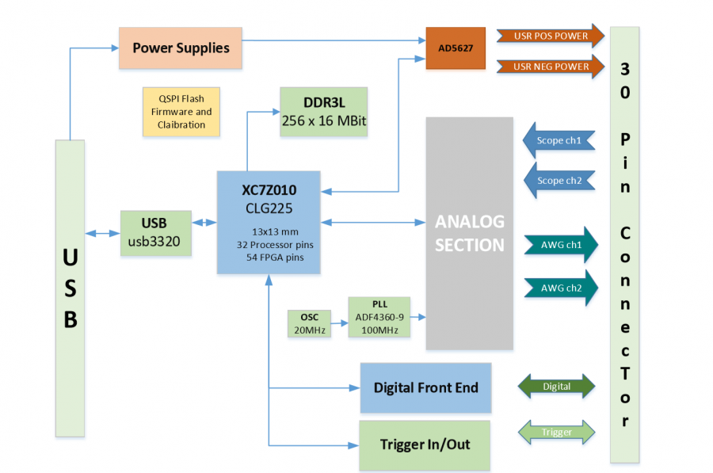
ADALM2000 Block Diagram
Notes:
M2k’s core is the Single Core Zynq 7010-4334
-it has a qspi flash for storing calibration data, a DDR3 memory for fast data transfers, analogic front-end with AD9963 ADC/DAC for Analog ins and outs

Slide 12
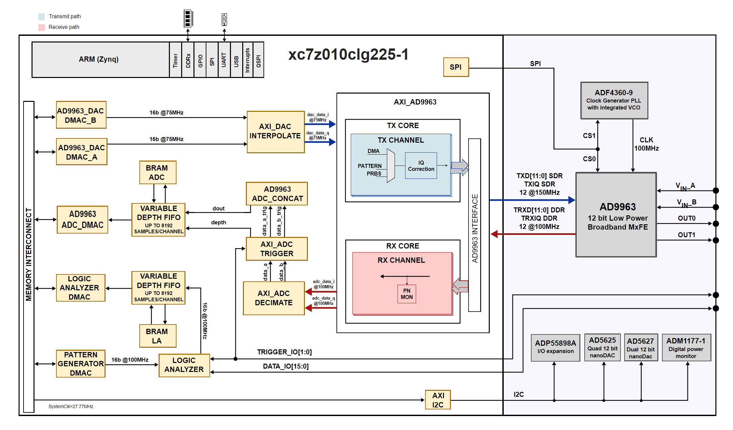
ADALM2000 HDL Architecture
Notes:
We won’t go into deep details here, but you can observe the hdl project mainly revolves around the two main paths, for transmit and receive, together with the memory access blocks and further control of the AD9963 ADC/DAC, main converter for scope and signal generator instruments

Slide 13
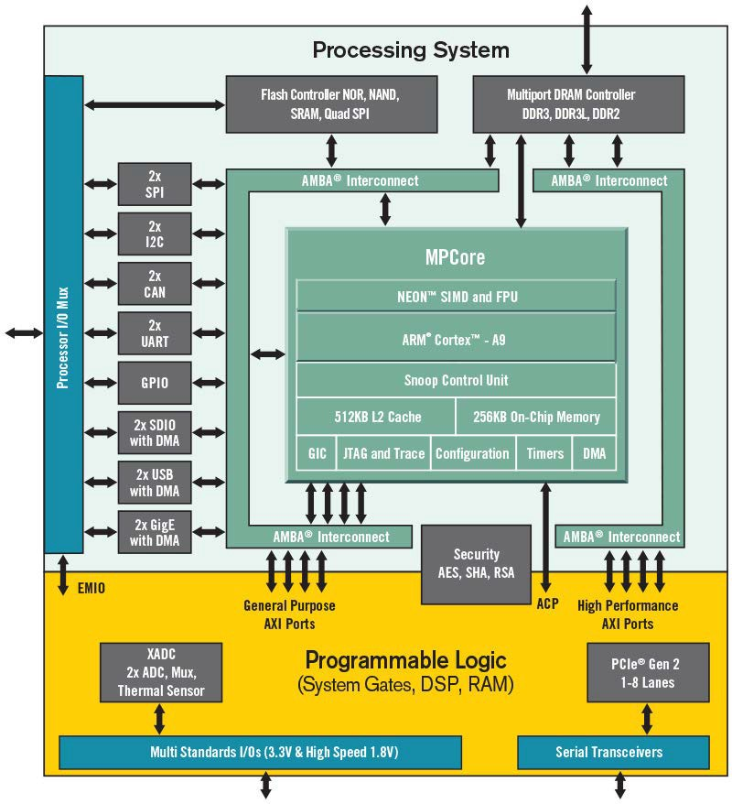

ADALM2000 HDL Architecture
Zynq:
Single Core Zynq 7010-4334
ARM Cortex-A9 MPCore (666.6 MHz)
NEON™ SIMD Engine
Single/Double Precision Floating Point Unit
USB 2.0 OTG
SPI
FPGA
28K Logic Cells
17,600 LUTs
35,200 Flip Flops
2.1Mb
80 DSP Slices
Single CLG225 (13x13) 0.8 mm pitch
32 MIO pins
16 DDR data
4 pairs of XADC signals
54 FPGA High Range Pins (1.2V to 3.3V)
https://www.xilinx.com/products/silicon-devices/soc/zynq-7000.html
Notes:
To mention about the fact that Linux is running on the chip

Slide 14
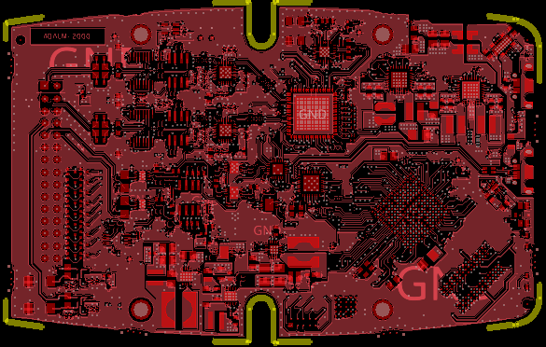
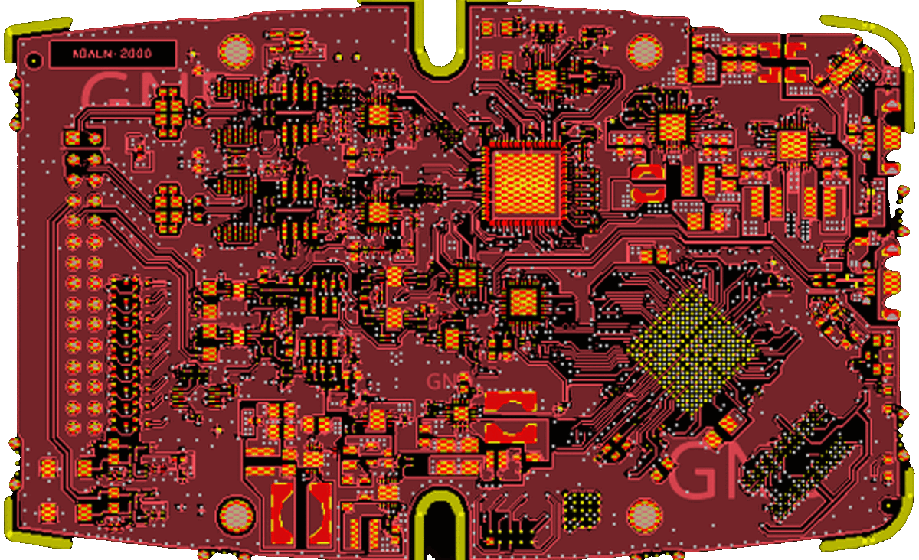
ADALM2000 Design
Design is open, just like all other ADI designs
Shows a full system design
Connector signals
Analog front-end
Schematics, Gerbers, BOM, Allegro Files posted
https://wiki.analog.com/university/tools/m2k/devs/hardware
Passes FCC and CE tests
Power Supplies
Analog Devices AD9963
Xilinx Zynq 7Z010
Micron DDR3L MT41K256M16
Power supplies

Slide 15
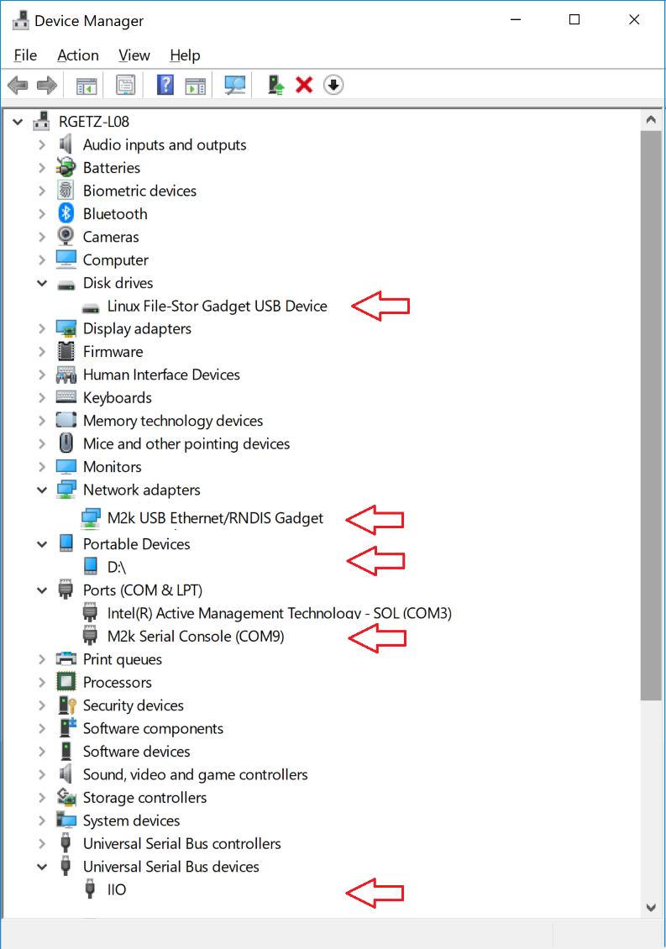
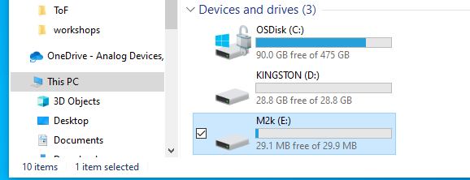
Connecting With ADALM2000
ADALM2000 enumerates four devices
Mass storage
Ethernet (RNDIS)
Serial
IIO

Slide 16
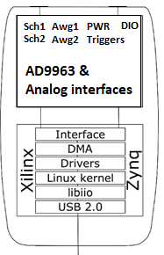
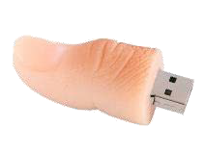
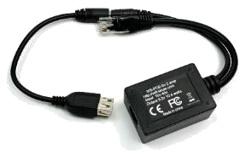



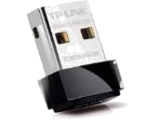
ADALM2000(M2K) USB OTG Connectivity Options
Connect to host
USB Thumb Drive
USB LAN
USB WiFi
Linux
Mac
Windows
Notes:
Different ways the board is seen

Slide 17
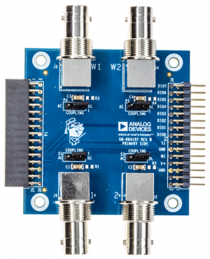
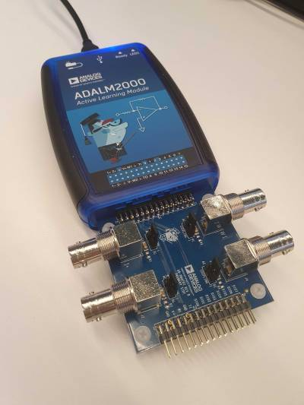
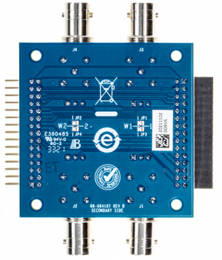
ADALM2000 add-on boards
M2K is compatible with some add-on boards, which increase its capabilities:
AD-M2KBNC-EBZ - allows the user to connect oscilloscope probes and other test leads to the analog inputs of M2K
Features:
AC or DC coupling on all channels
Possibility to reconfigure the analog inputs as differential input channels
Access to all other ADALM2000 output pins
Oscilloscope probes, BNC to grabber cables and mini grabber test clips are included in the package

Slide 18
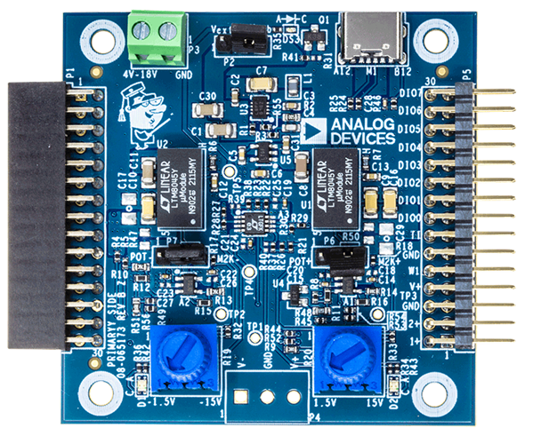
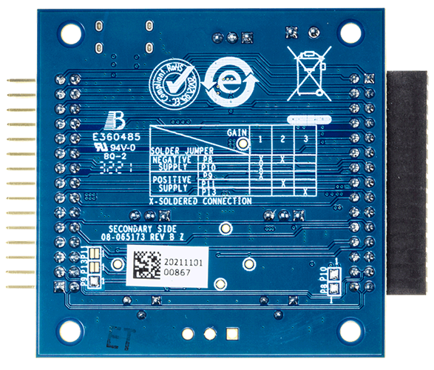
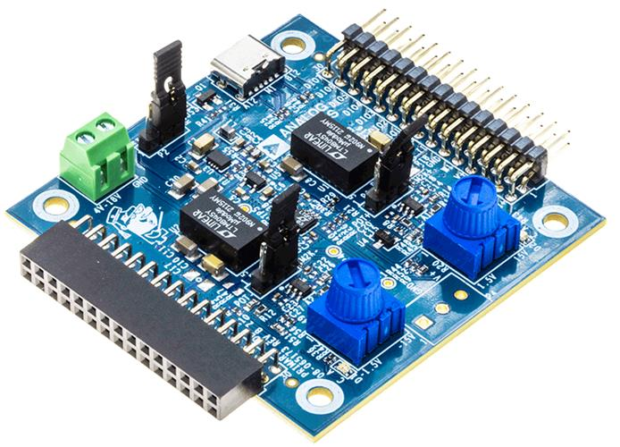
ADALM2000 add-on boards
AD-M2KPWR-EBZ - increases the output current capability up to 700mA Features:
ADALM2000 compatible
USB Type-C powered (no Power Delivery included)
Outputs:
Two variable power supplies that track M2K user supplies:
0V to 5V (400mA in USB power mode)
-5V to 0V (400mA in USB power mode)
Two independent variable power supplies, adjusted by potentiometers:
1.5V to 15V (up to 700mA if powered with 18V)
-15V to -1.5V (up to 700mA if powered with 18V)
Notes:
This board can be also used as a standalone benchtop power supply with positive and negative outputs.

Slide 19
Getting started with ADALM2000
Install the drivers – available for: Windows (https://github.com/analogdevicesinc/plutosdr-m2k-drivers-win/releases),
Linux (https://wiki.analog.com/media/university/tools/pluto/drivers/plutosdr-m2k-udev1.0amd64.deb),
Mac Osx (https://wiki.analog.com/university/tools/pluto/drivers/osx)
Plug the device into USB and check it’s being recognized by the OS
Install Scopy (https://github.com/analogdevicesinc/scopy/releases/download/v1.3.0/scopy-v1.3.0-Windows-setup.exe )
Start using it

Slide 20
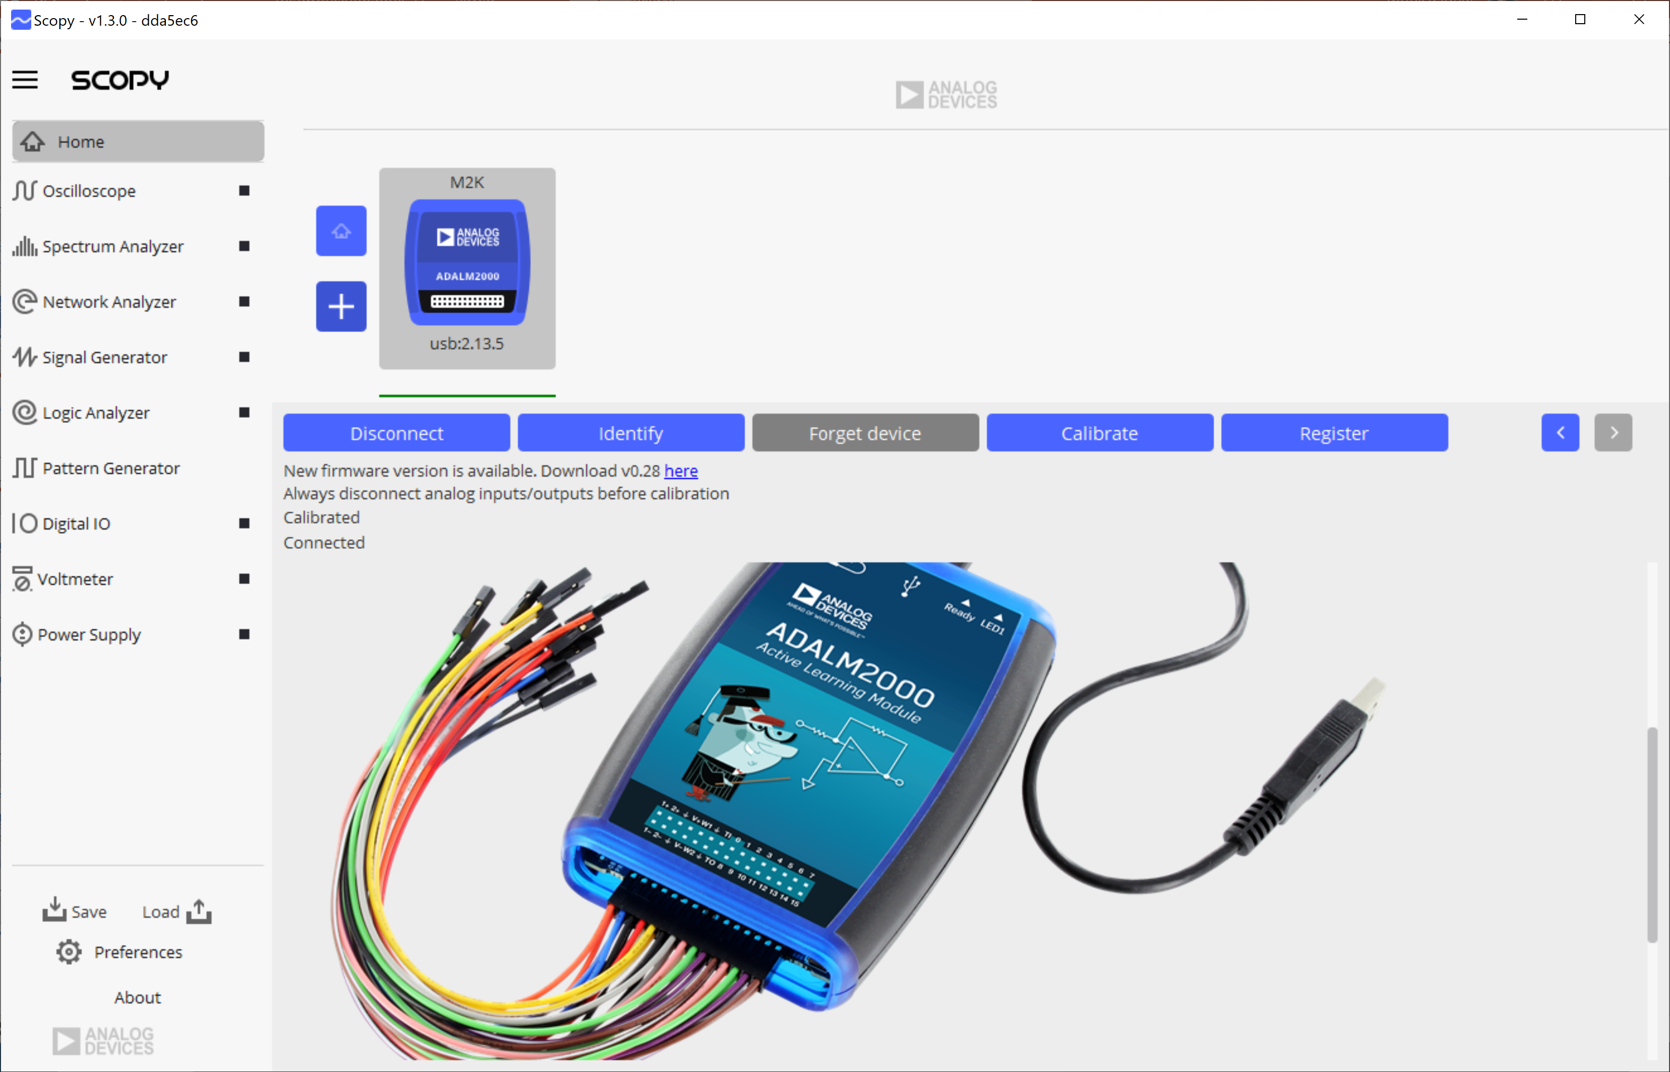
Scopy
Install
Windows download: Installer for latest release (Windows 64/32-bit)
Connect to a USB or remote device
Cross platform
Multiple instruments:
Oscilloscope
Network Analyzer
Spectrum Analyzer
Signal generator
Logic Analyzer
Pattern Generator
Voltmeter
Power supplies

Slide 21
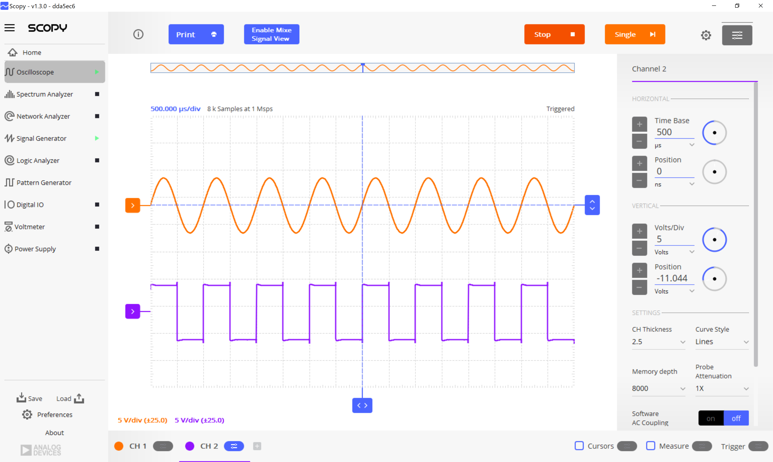
Scopy Oscilloscope
Channel Settings: time base, vertical position, color, etc.
Cursors
Measure
Trigger
Math channels
Reference channels
Mixed signal view
Complete Scope user guide found at: https://wiki.analog.com/university/tools/m2k/scopy/oscilloscope
Scope features

Slide 22
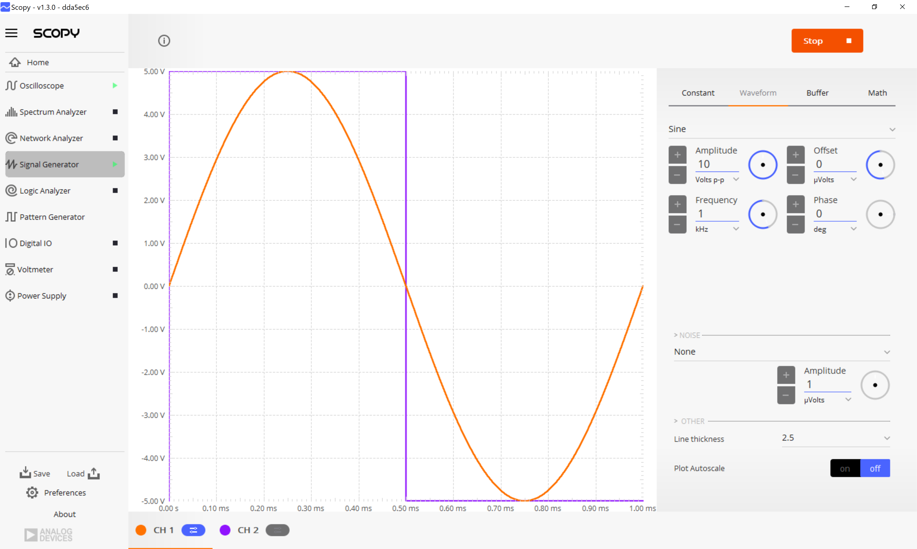
Scopy Signal Generator
Waveforms types:
Multiple noise signal types
Complete Signal Generator user guide found at: https://wiki.analog.com/university/tools/m2k/scopy/siggen
Signal Generator features
Four types of signals:
Waveform - AC signal with various customizable parameters
Buffer - signal is imported from a file
Math - signal is defined by a mathematical equation
Constant - DC signal at a user selectable amplitude
Square
Triangle
Trapezoidal
Rising sawtooth
Falling sawtooth
Parameters: Amplitude, Offset, Frequency, Phase
Sine

Slide 23
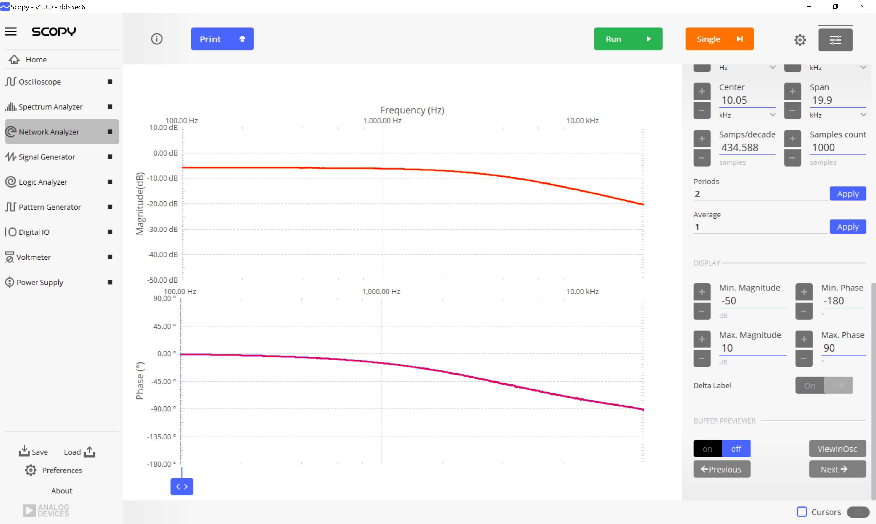
Scopy Network Analyzer
Waveform Settings: amplitude, offset, settling time, etc.
Response settings: DC filtering, Gain mode, settling time
Sweep settings: scale, frequency range, samples, periods, average
Display settings: Bode, Nyquist, Nichols plots
Buffer previewer
Complete Network Analyzer user guide found at: https://wiki.analog.com/university/tools/m2k/scopy/networkanalyzer
Network Analyzer features
It uses Signal generator channels as stimulus and Scope channels are reference to determine the transfer function of the circuit under test

Slide 24
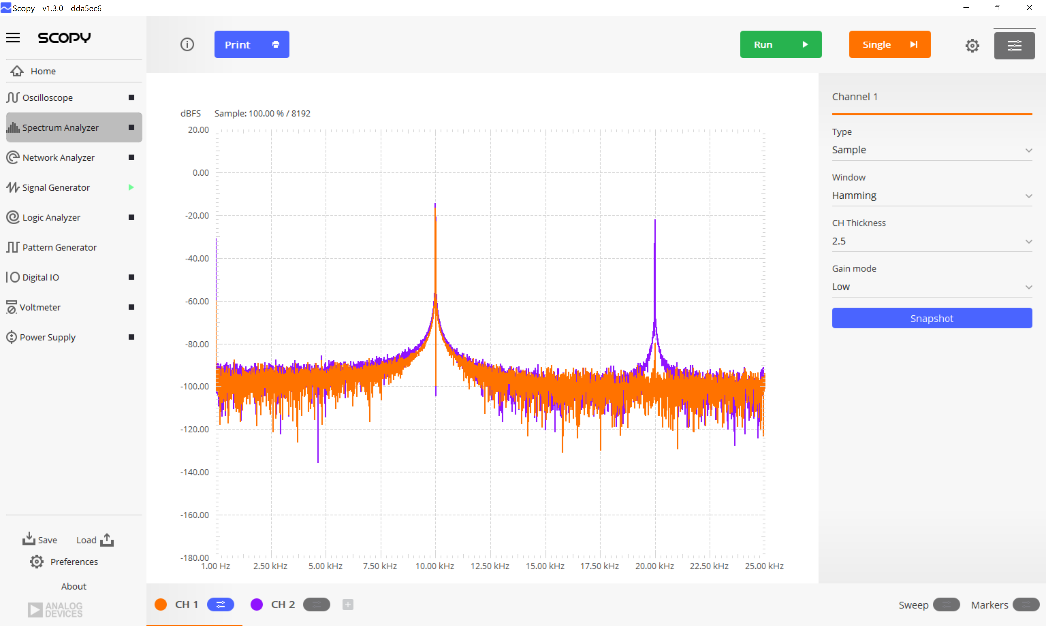
Scopy Spectrum Analyzer
Sweep settings: frequency switch, span, amplitude controls, resolution bandwidth
Markers settings: for measuring magnitude on a specific frequency
Complete Spectrum Analyzer user guide found at: https://wiki.analog.com/university/tools/m2k/scopy/spectrumanalyzer
Spectrum Analyzer features
Channel Settings: type, window, gain

Slide 25
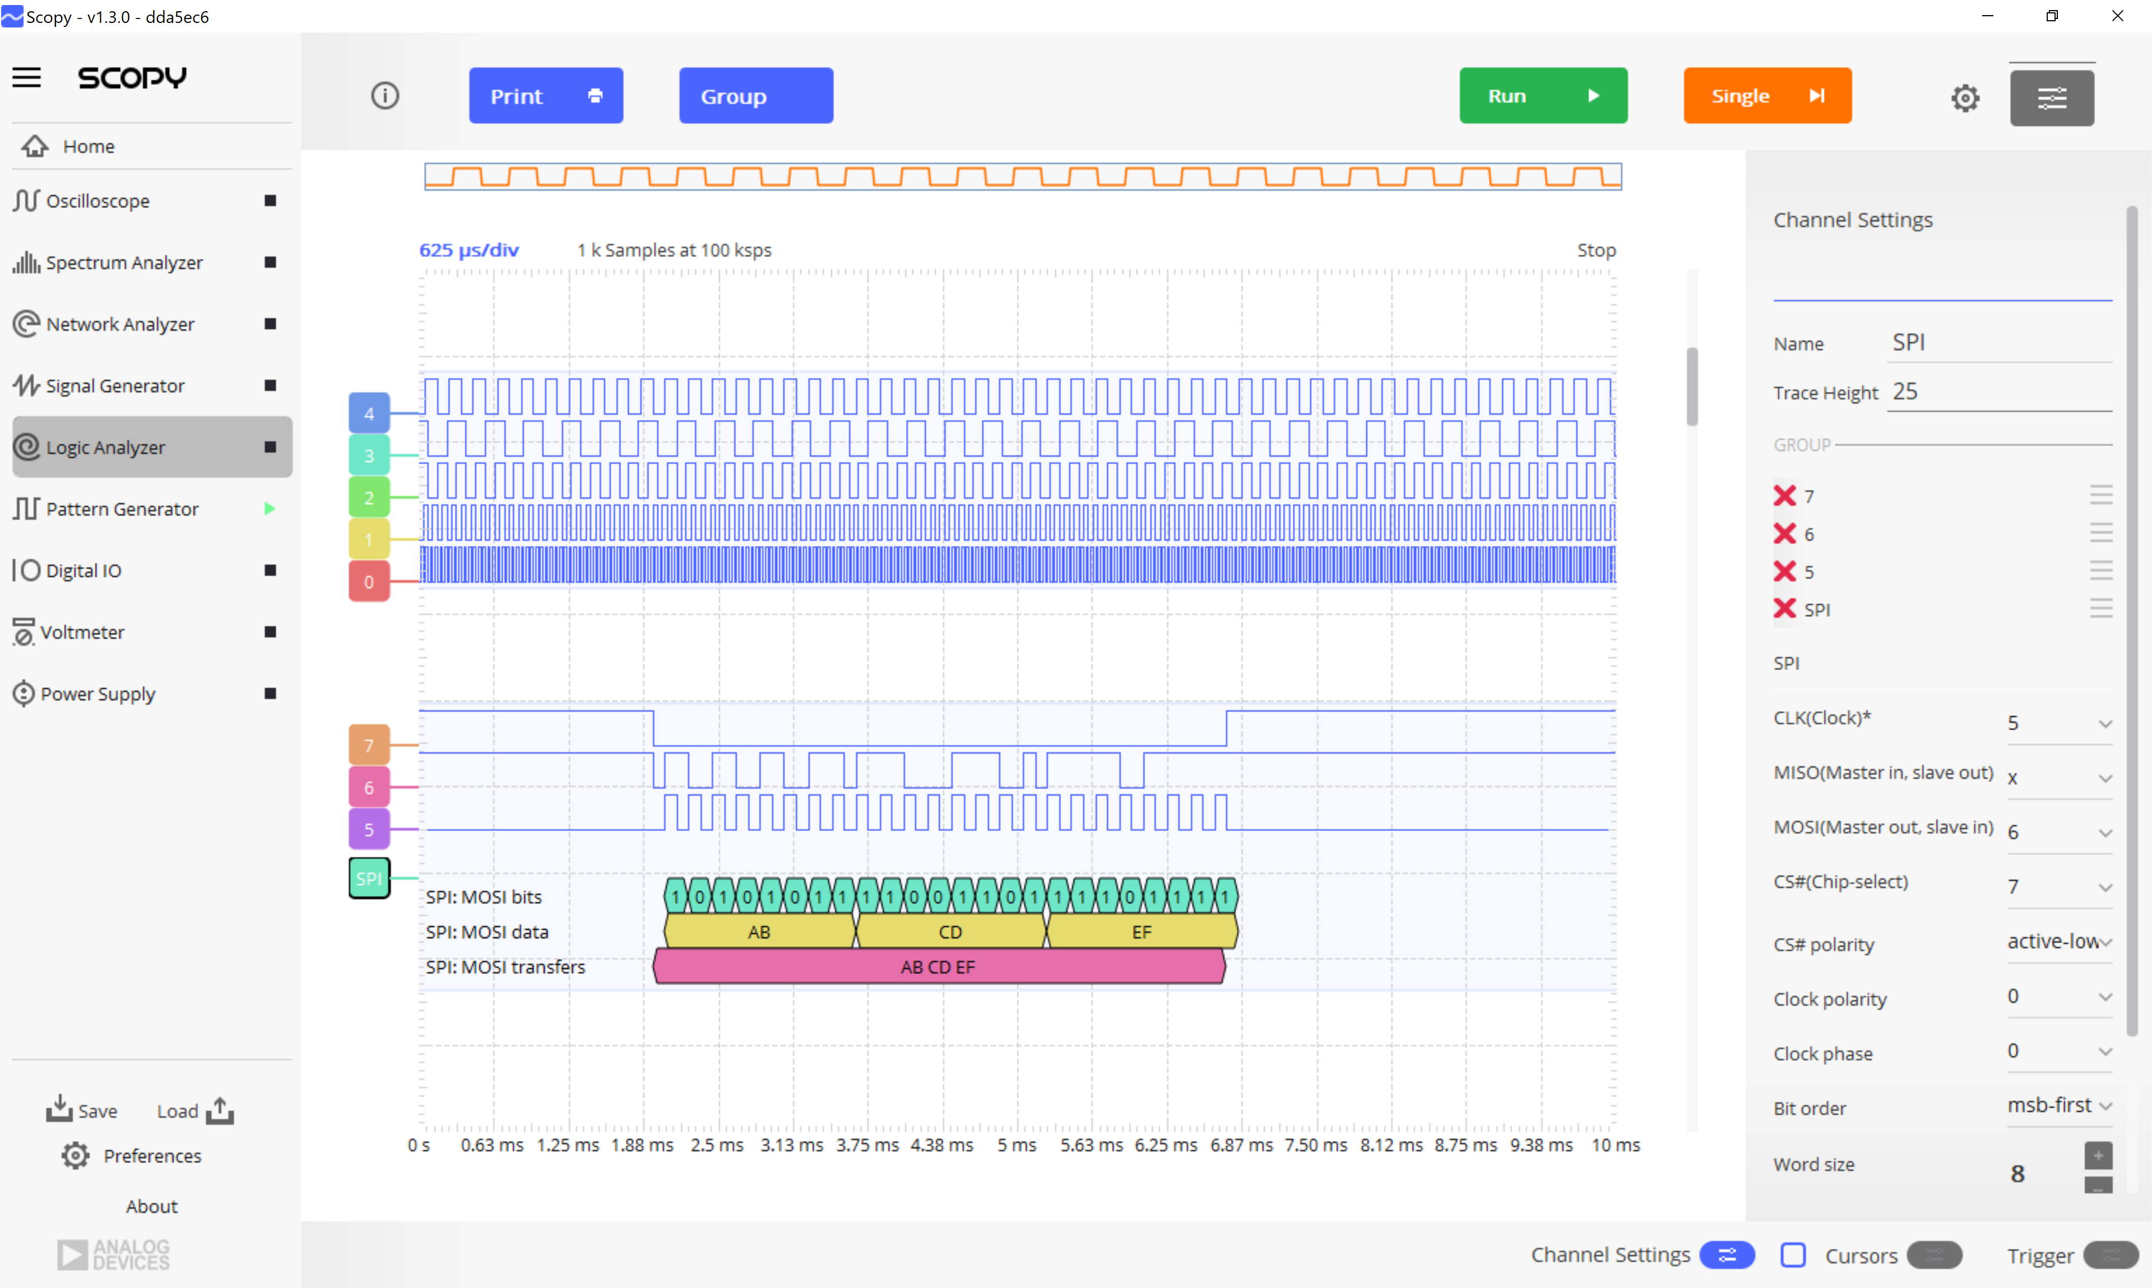
Scopy Logic Analyzer
Complete Logic Analyzer user guide found at: https://wiki.analog.com/university/tools/m2k/scopy/logicanalyzer
Logic Analyzer features
16 channels
Decoders enumerator
Channel specific settings
Export function
Acquisition settings
Trigger

Slide 26
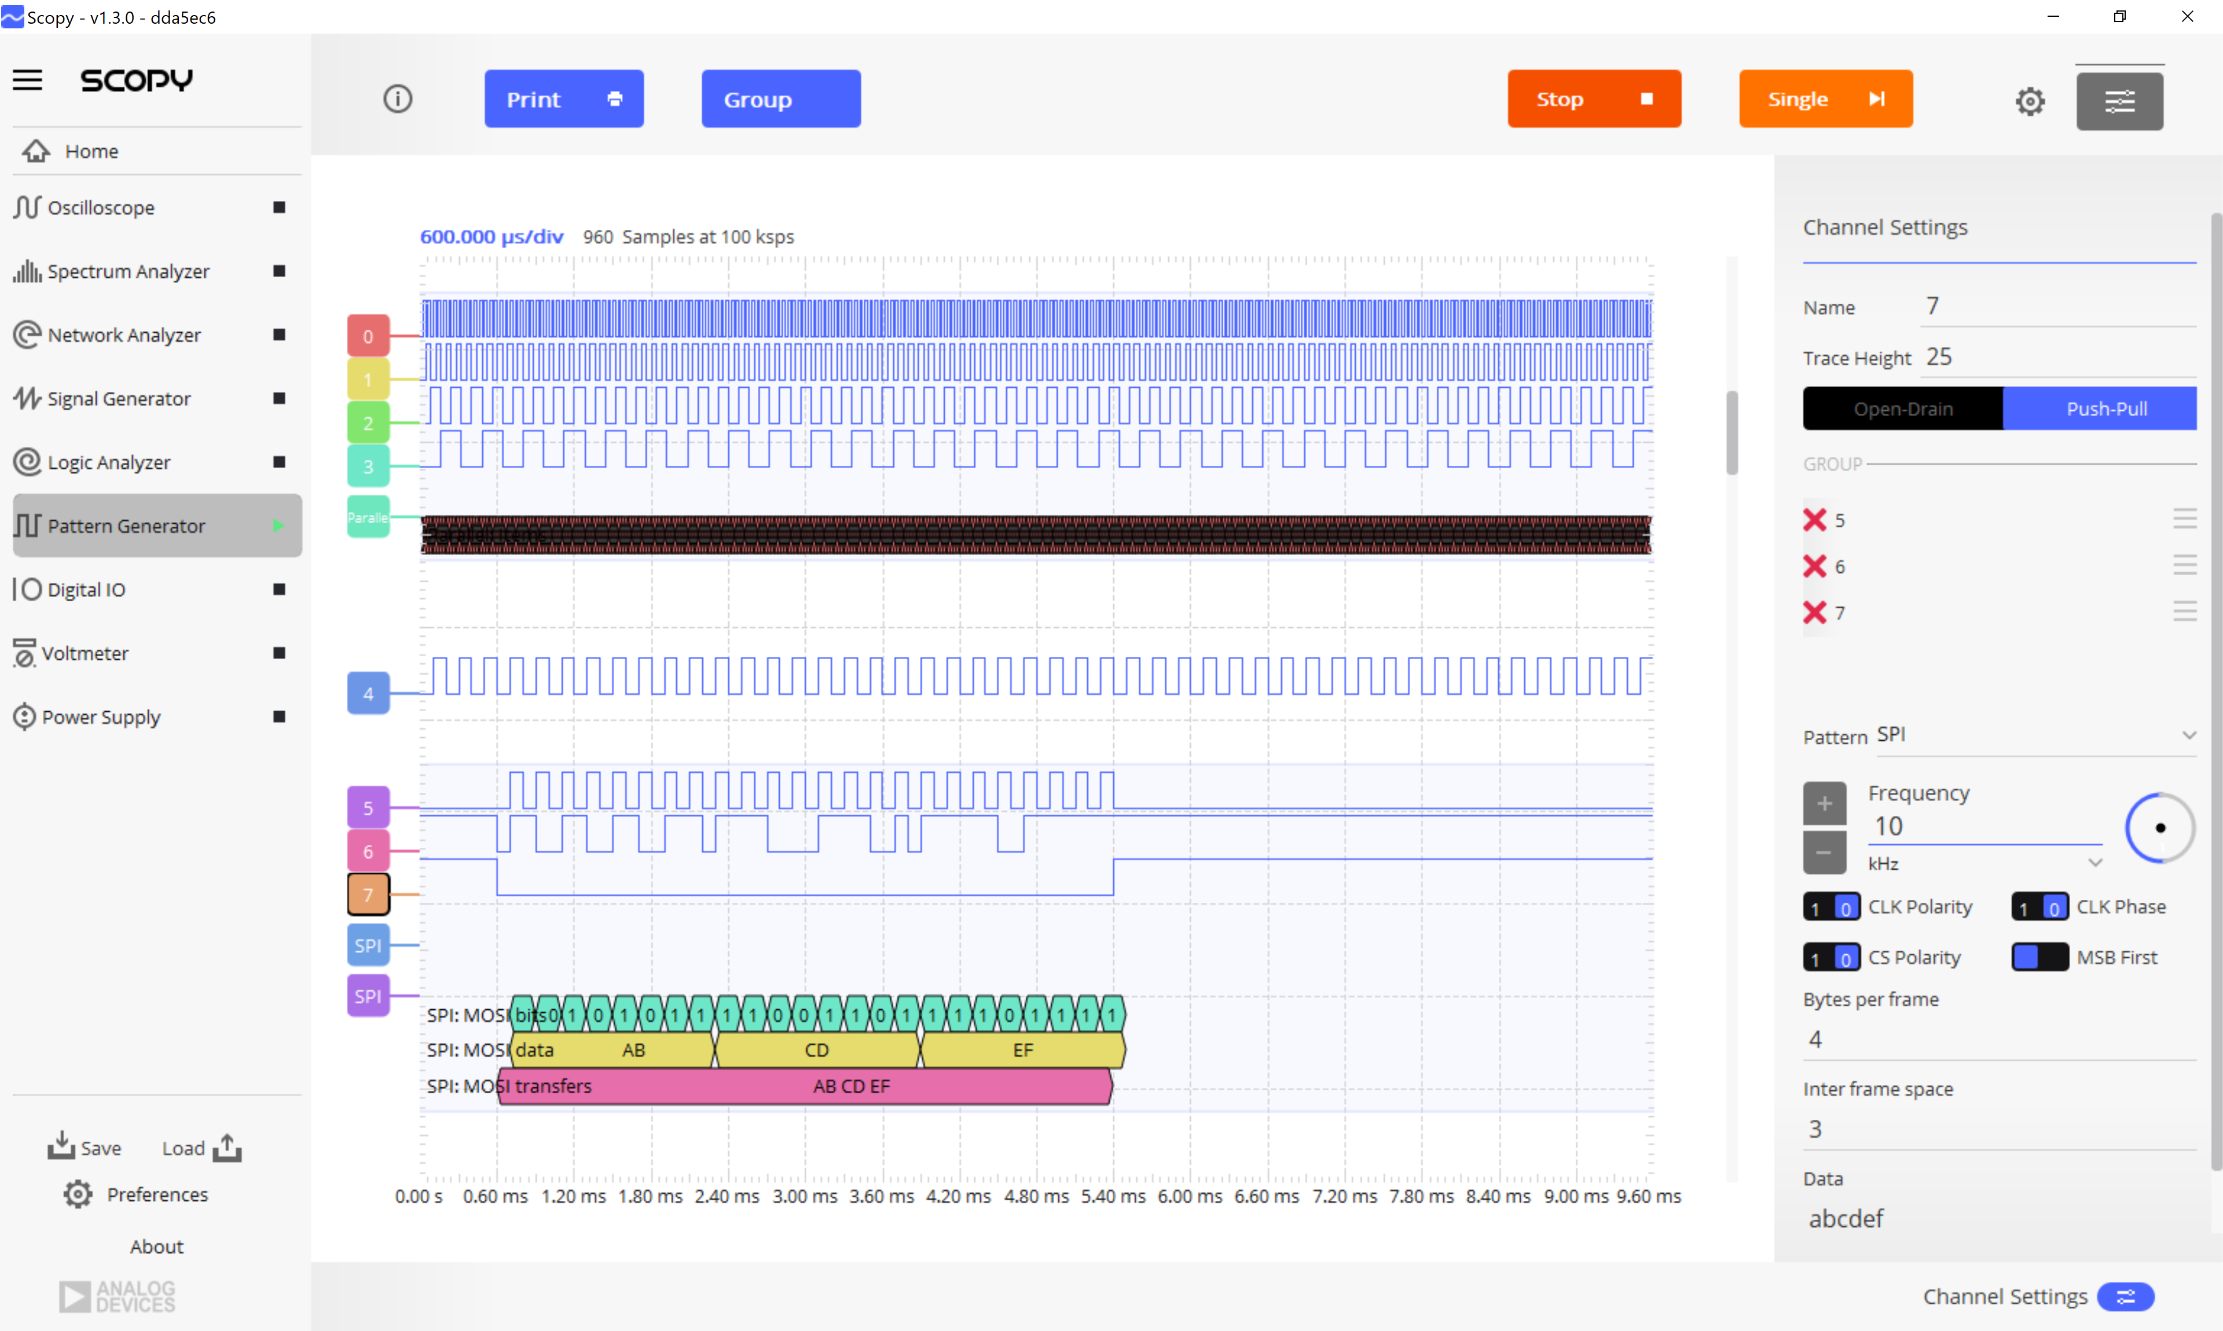
Scopy Pattern Generator
Complete Pattern Generator user guide found at: https://wiki.analog.com/university/tools/m2k/scopy/pattgen
Pattern Generator features
Multiple implemented patterns to be generated:
Clock – generates a clock signal having user selectable frequency, phase and duty cycle.
Number - generates a user selectable number
Random – generates random values at a user selectable frequency.
Binary Counter – generates a binary counter on the channels in the channel group.
UART – generates a UART message
SPI - generates a SPI message
I2C - generates an I2C message
Gray Counter - generates a gray counter on the channels in the channel group
Import - imports a CSV file and outputs it's content
Interacts with Logic Analyzer in a loop back function

Slide 27
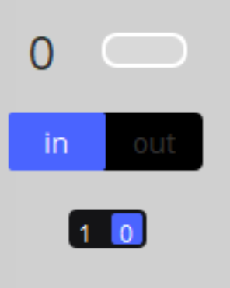
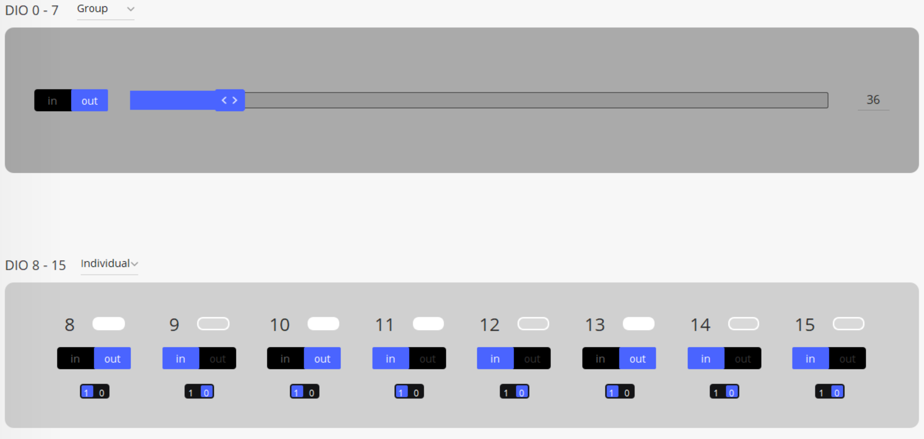
Scopy Digital IO
1
2
Complete Digital IO user guide found at: https://wiki.analog.com/university/tools/m2k/scopy/digitalio
Digital IO features
Interacts with both Logic Analyzer and Pattern Generator
Digital channel number - the physical pin of the M2K
Channel input state - indicates the input read by the M2K
Channel direction - indicates whether the channel is set to input/output
Channel output state - indicates the output value configured of the M2K
3
4

Slide 28
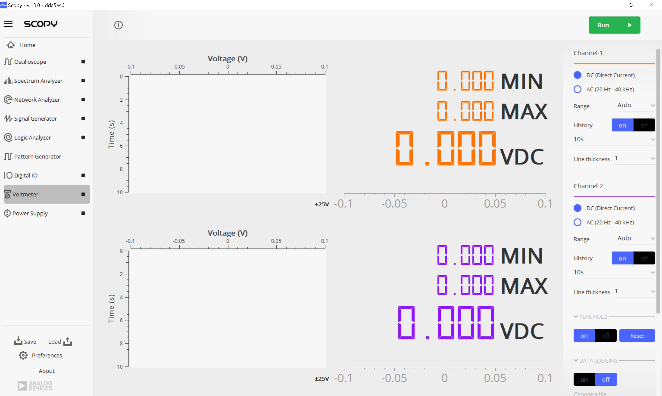
Scopy Voltmeter
Complete Voltmeter user guide found at: https://wiki.analog.com/university/tools/m2k/scopy/voltmeter
Voltmeter features
Displays the voltage readings on the two channels of the ADC.
Control Menu
History Plot
Digital Display

Slide 29
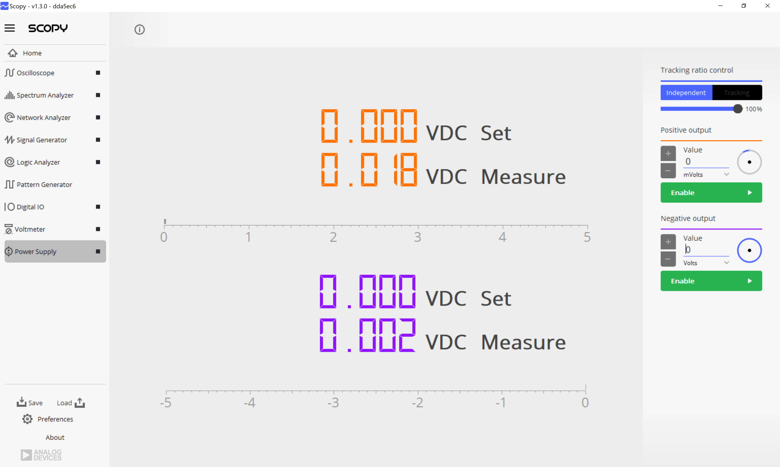
Scopy Power Supply
Complete Power supply user guide found at: https://wiki.analog.com/university/tools/m2k/scopy/power-supply
Power Supplies features
Positive and negative voltage of the M2K
Tracking ratio control – independent or tracking - allows you to express the negative output (V- pin) as a function of the positive output: V- =V-(ratio * V+).
Supplies control

Slide 30
Hands-on Workshop:
Introduction to Software Defined Instrumentation
Part 2
Hands on Lab:
Demo 1
Scope and Signal generator channels – Cascaded LP filters
Demo 2
Digital Pattern Generator and Oscilloscope – AD5626 component – SPI-controlled and analog signal visualized using Oscilloscope

Slide 31



Hands On Lab
By the end of this hands-on activity, you will learn:
How to use a desktop Oscilloscope and Signal generator channels by operating a Network Analyzer, as well as Digital Pattern generator
How to interface an analog front end simple circuit with M2K channels
How to generate and display signals with the lab tools Analog Devices provides
http://www.iconarchive.com/show/noto-emoji-objects-icons-by-google/62807-radio-icon.html
http://www.streamlineicons.com
http://pixelkit.com

Slide 32
Hands On Lab
Equipment used:
M2K board
ADALP2000 kit components
Demo 1
Scope and Signal generator channels – Cascaded LP filters
Demo 2
Digital Pattern Generator and Scope – AD5626 component –SPI controlled and analog signal visualized using Scope
http://www.iconarchive.com/show/noto-emoji-objects-icons-by-google/62807-radio-icon.html
http://www.streamlineicons.com
http://pixelkit.com

Slide 33
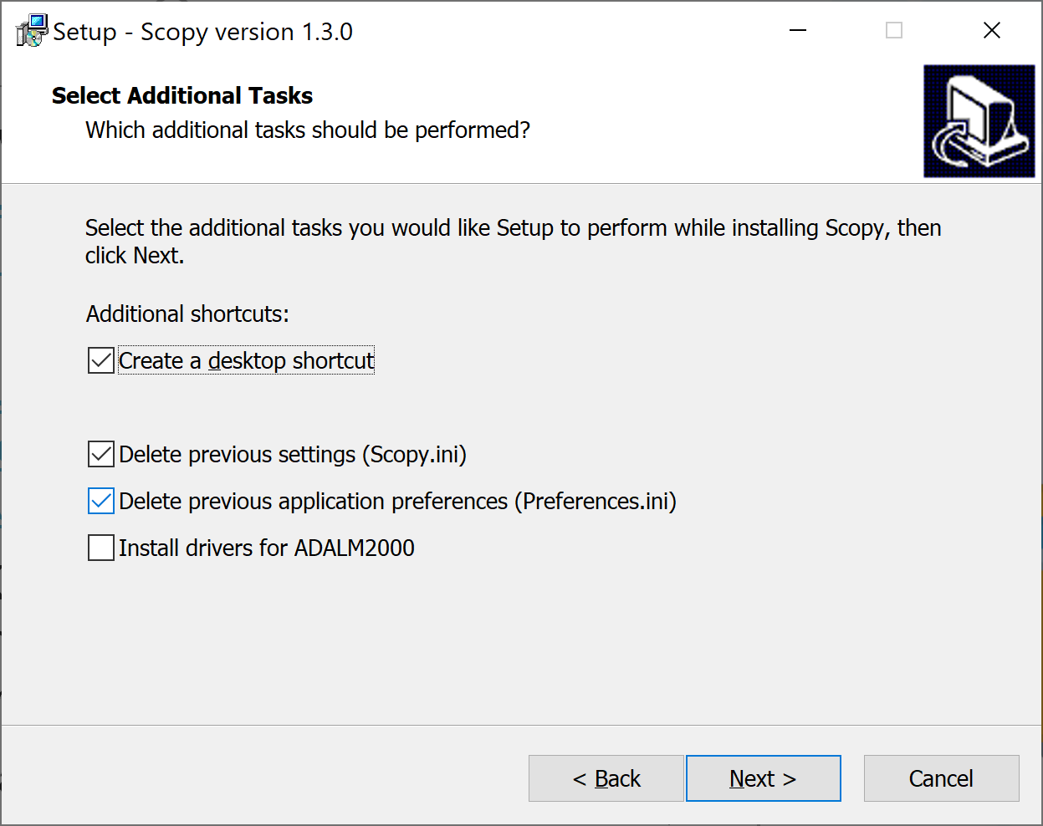
Hands On Lab
Install windows drivers from: https://github.com/analogdevicesinc/plutosdr-m2k-drivers-win/releases
Install Scopy software from: https://github.com/analogdevicesinc/scopy/releases/download/v1.3.0/scopy-v1.3.0-Windows-setup.exe
Plug the M2K board in and open device manager – check the board is being recognized and appears there
Open Scopy app
Connect M2K to the Scopy

Slide 34
Hands On Lab
Demo 1
Scope and Signal generator channels – Cascaded LP filters
Materials:
ADALM2000 Active Learning Module Solder-less breadboard, and jumper wire kit
2 1 KΩ resistors 2 0.1 uF capacitors (marked 104)
http://www.iconarchive.com/show/noto-emoji-objects-icons-by-google/62807-radio-icon.html
http://www.streamlineicons.com
http://pixelkit.com

Slide 35
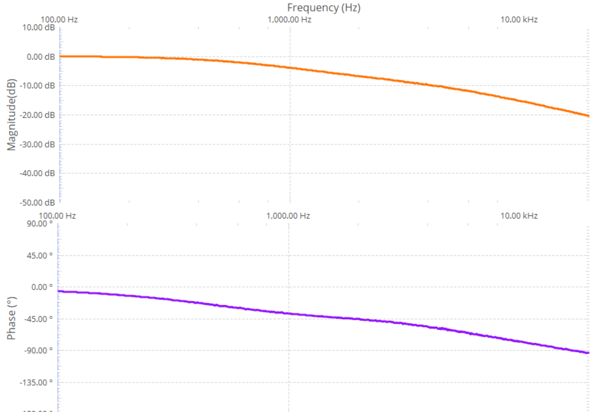
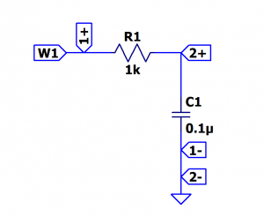
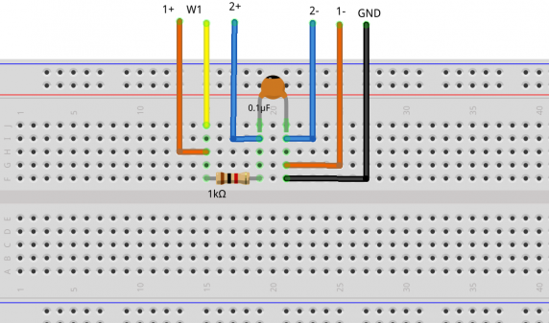
Hands On Lab
Procedure:
Open Network Analyzer
Set the sweep to logarithmic
Set the start frequency to 100Hz and stop to 20kHz
Set the magnitude axis between -50dB and 10dB
Set the phase axis between -180 and 90 degrees
Demo 1
Scope and Signal generator channels – Cascaded LP filters
First order Low Pass Filter
Hardware setup

Slide 36
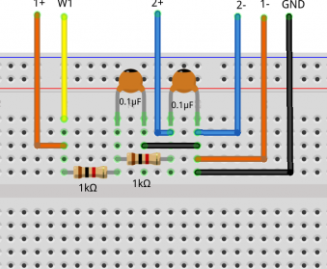
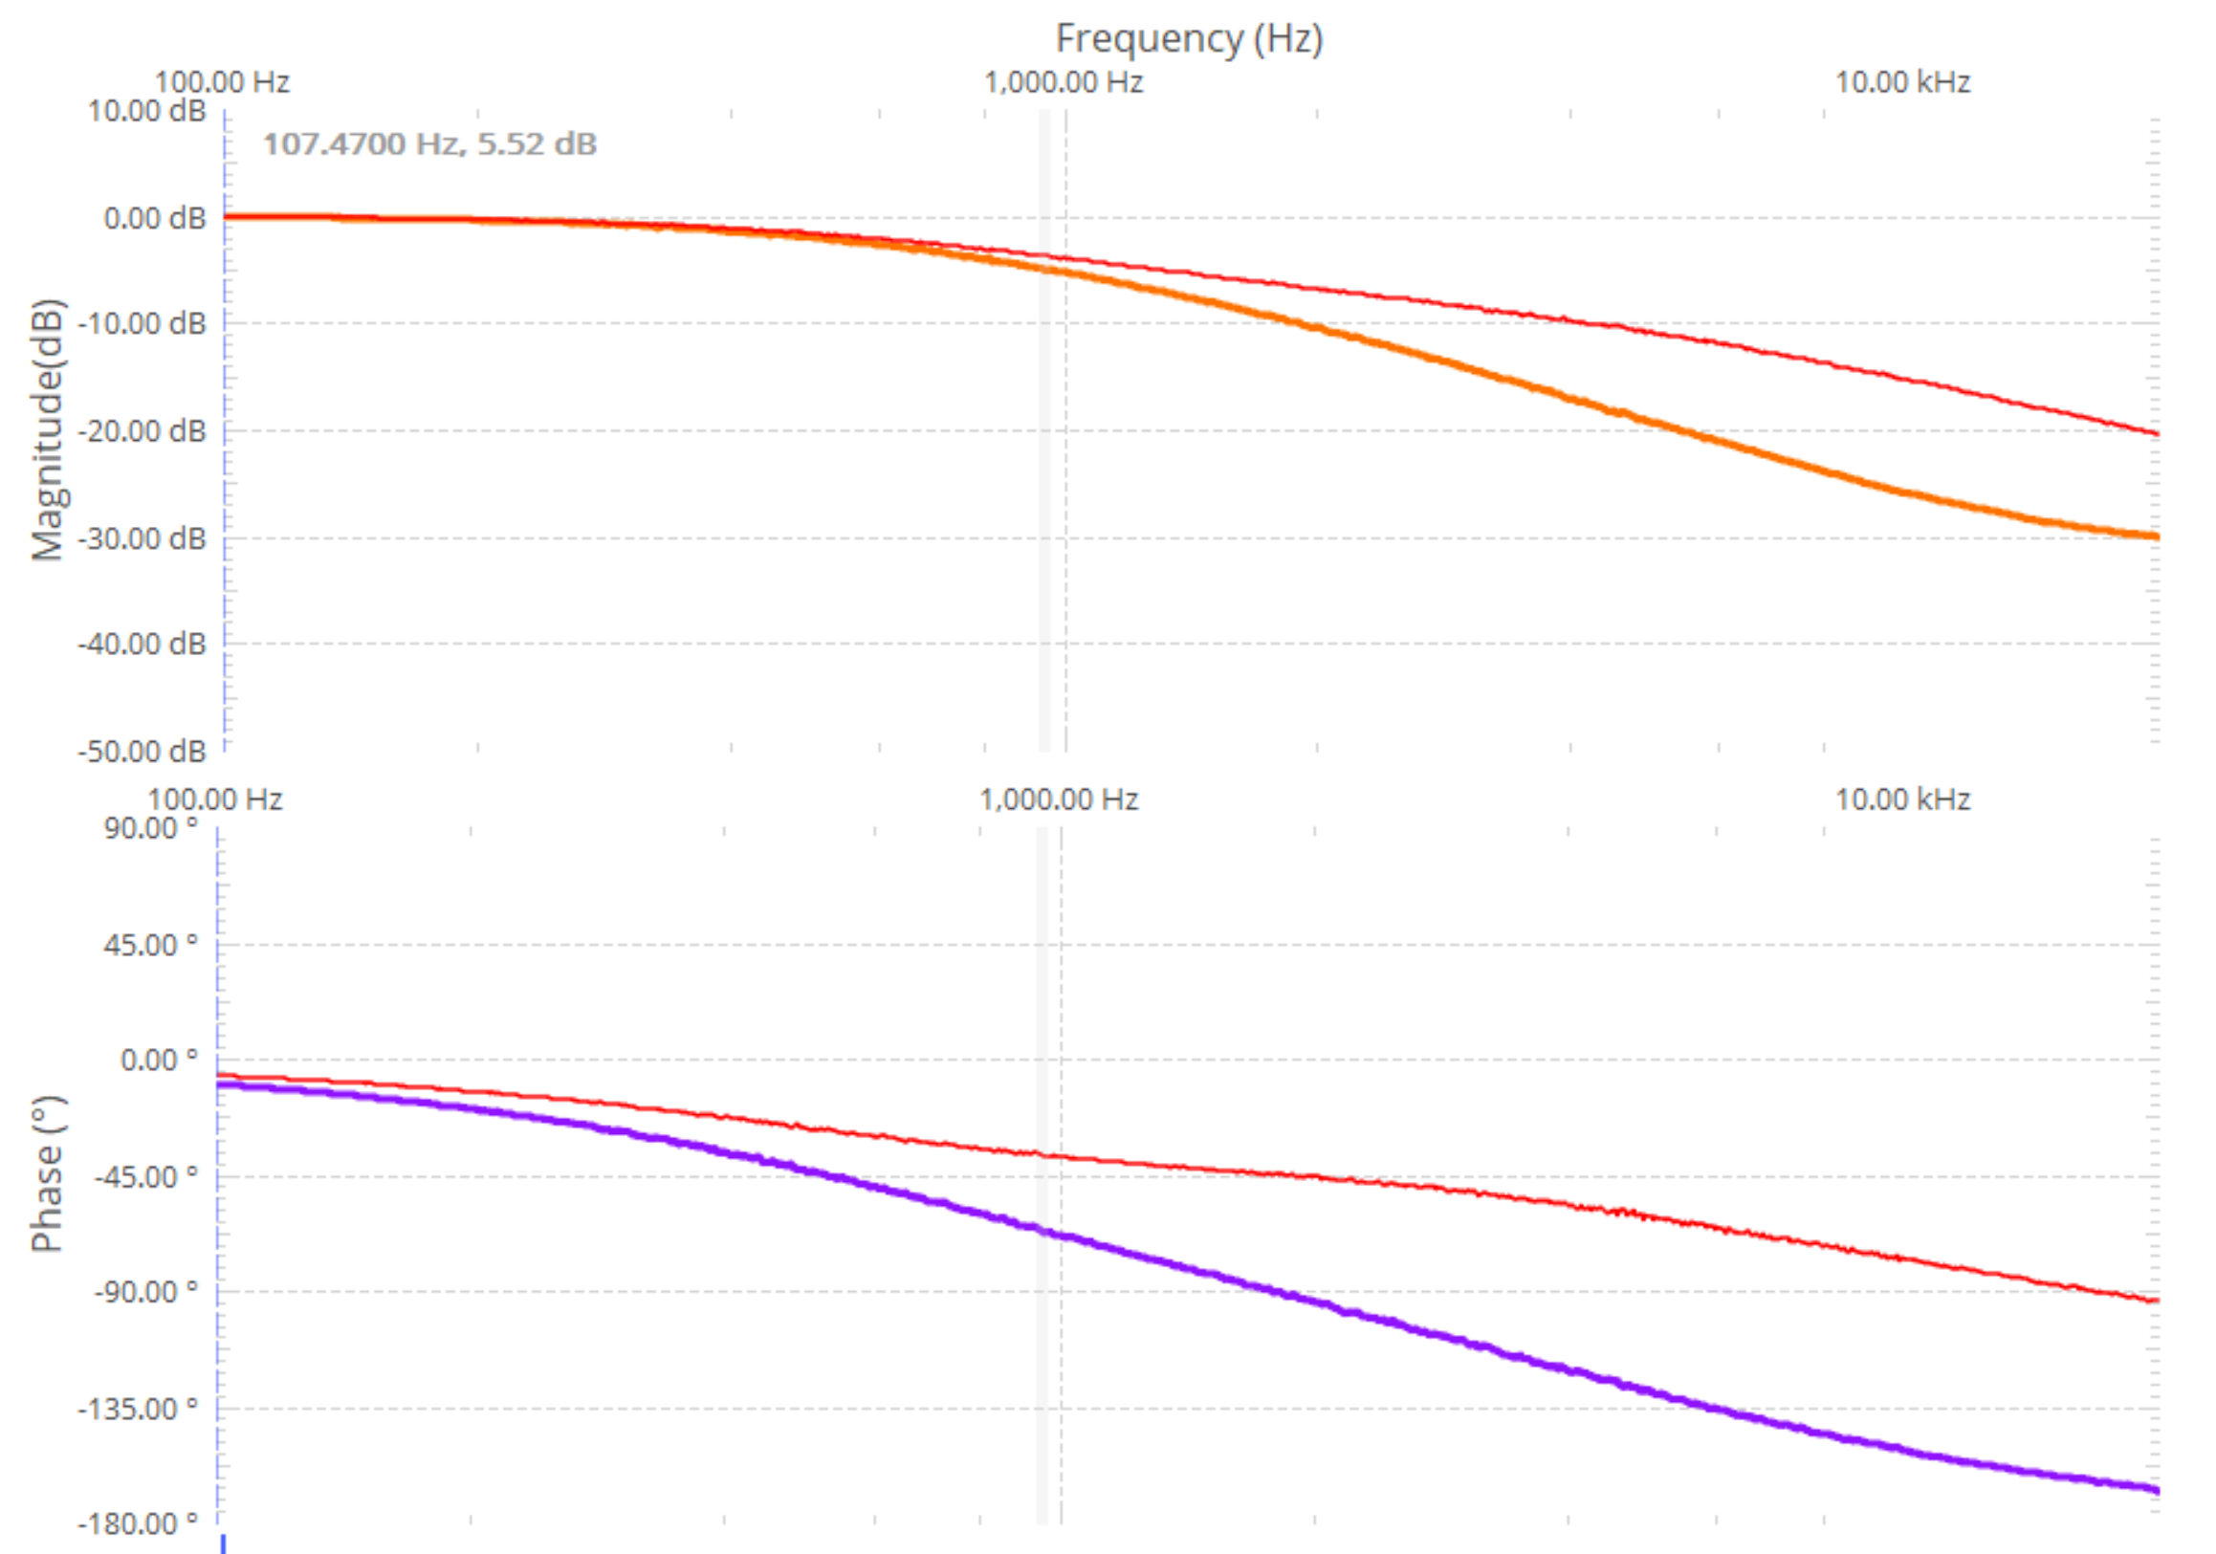
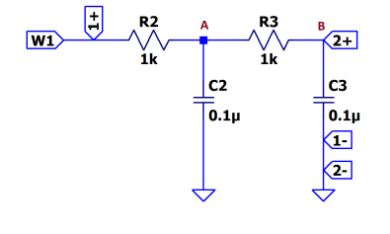
Hands On Lab
Procedure:
Connect the Scope Channel 2 after the first RC group and do a single sweep
Take a signal snapshot to preserve the result as a reference
Connect the Scope Channel 2 after the second RC stage and perform another sweep
Demo 1
Scope and Signal generator – Cascaded LP filters
Second order Low Pass Filter
Hardware setup

Slide 37
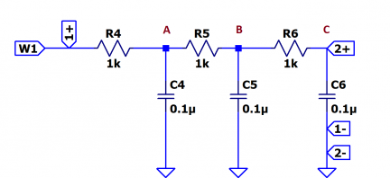
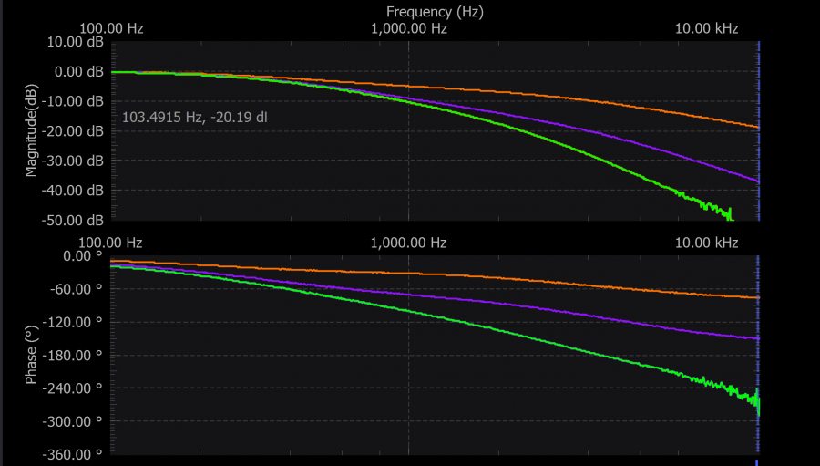
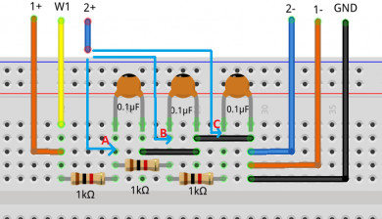
Hands On Lab
Demo 1
Scope and Signal generator – Cascaded LP filters
Third order Low Pass Filter
Hardware setup
Procedure:
Connect the Scope Channel 2 after the first RC group and do a single sweep
Take a signal snapshot to preserve the result as a reference
Connect the Scope Channel 2 after the second RC stage and perform another sweep, take a snapshot
Connect the Scope channel 2 in point C, indicated in the hardware setup, to obtain the frequency response and perform another sweep.

Slide 38
Hands On Lab
Demo 2
Digital Pattern Generator and Scope – AD5626 component – SPI controlled and analog signal visualized using Scope
Materials used:
ADALM2000 Active Learning Module Solder-less breadboard Jumper wires 1 - AD5626 12-bit nanoDAC 1 - 2.2 KΩ resistor 1 - 0.001 uF capacitor(marked 102) 1 - 0.1 uF capacitor(marked 104) 1 - 10 uF capacitor
http://www.iconarchive.com/show/noto-emoji-objects-icons-by-google/62807-radio-icon.html
http://www.streamlineicons.com
http://pixelkit.com

Slide 39

Hands On Lab
Demo 2
Digital Pattern Generator and Scope – AD5626 component – SPI controlled and analog signal visualized using Scope
Theory of operation:
AD5626 SPI transfer defined below
http://www.iconarchive.com/show/noto-emoji-objects-icons-by-google/62807-radio-icon.html
http://www.streamlineicons.com
http://pixelkit.com

Slide 40


Hands On Lab
Demo 2 – SPI Protocol basics
Notes:
Explain a little the spi protocol and signals

Slide 41



Hands On Lab
Demo 2
Digital Pattern Generator and Scope – AD5626 component – SPI controlled and analog signal visualized using Scope
Hardware setup:
Procedure:
Connect the Vp power supply to the Vdd of the chip, set it to 5V
Connect the GND pin to the GND of the M2K
Connect the digital pins to the corresponding chip pins as shown in the schematic.
Configure the SPI interface in pattern generator to match the timing diagram in the AD5626 datasheet.
Beware not to connect the supply pins of the chip to the positive power of ADALM2000 and GND in a reversed order!

Slide 42

Hands On Lab
Demo 2
Digital Pattern Generator and Scope – AD5626 component – SPI controlled and analog signal visualized using Scope
Instruments setup
Pattern generator signals:
DIO0 - /CS
DIO1 – SCLK
DIO2 – SDIN
DIO3 - /LDAC
DIO4 - /CLR
Pattern generator setup:
According to the time diagram, minimum SPI clock period is 30ns, set the SPI frequency to 1MHz
Set CLK polarity and Phase to 1
Set number of bytes per frame to 2
Configure the /LDAC and /CLR signals
Notes:
From the datasheet we know that the shift register contents are updated on the rising edge of /LDAC if /CLR is high.
Set the pattern of DIO4 (/CLR) as “Number” and enter the value 1.
/LDAC signal(DIO3) should have a rising edge before /CS falling egde and should be high as long as bits are transmitted serially.
In order to fulfill the previously stated conditions, DIO3 signal can be set as pulse type 100kHz frequency, Low nr of samples 5, High 75, for the set frequency of the SPI 1MHz.

Slide 43

Hands On Lab
Demo 2
Digital Pattern Generator and Scope – AD5626 component – SPI controlled and analog signal visualized using Scope
Conversion:
Open Scope instrument and connect Scope channel 1 to output of the AD5626
Set some values in the Data control of the pattern generator SPI configurator
Enable Channel 1 measurements
Check the values measured corresponds to the digital set one in the pattern generator
Change the initially transmitted values
Notes:
From the datasheet we know that the shift register contents are updated on the rising edge of /LDAC if /CLR is high.
Set the pattern of DIO4 (/CLR) as “Number” and enter the value 1.
/LDAC signal(DIO3) should have a rising edge before /CS falling egde and should be high as long as bits are transmitted serially.
In order to fulfill the previously stated conditions, DIO3 signal can be set at 13kHz frequency and 160 degrees phase.

Slide 44

Hands On Lab
Conclusions:
ADALM2000 is a very versatile tool suited to use in various applications:
Lab setups
Advanced measurements
Learning platforms
Research
http://www.iconarchive.com/show/noto-emoji-objects-icons-by-google/62807-radio-icon.html
http://www.streamlineicons.com
http://pixelkit.com

Slide 45



Example using M2K as a radio receiver
Implementation
Block diagram
Hardware setup
GNU Radio application

Slide 46
Resources
ADALM2000 Wiki:
https://wiki.analog.com/university/tools/m2k
https://wiki.analog.com/university/tools/m2k/accessories/bnc
https://wiki.analog.com/university/tools/m2k/accessories/power
ADALM2000 Lab Activities:
https://wiki.analog.com/university/courses/electronics/labs
Virtual classroom:
https://ez.analog.com/community/university-program

Slide 47
Opportunities at ADI
Opportunities:
Internships
Jobs
Summer practice
Get hardware and support from ADI to develop your own projects

Slide 48

Our departments:
Hardware Design
FPGA Digital Design
Embedded Software
Applications Software
Applications Engineering
Send us your CV!
Check our available positions with the QR code:
To: Melinda.Zerkula@analog.com
Subject: Internship/Practica

Slide 49

Thank You! Questions?

